Slide 1
IOTA / North America
2022-2023 Interesting Observations
Norman Carlson – NA Review Coordinator

Slide 2
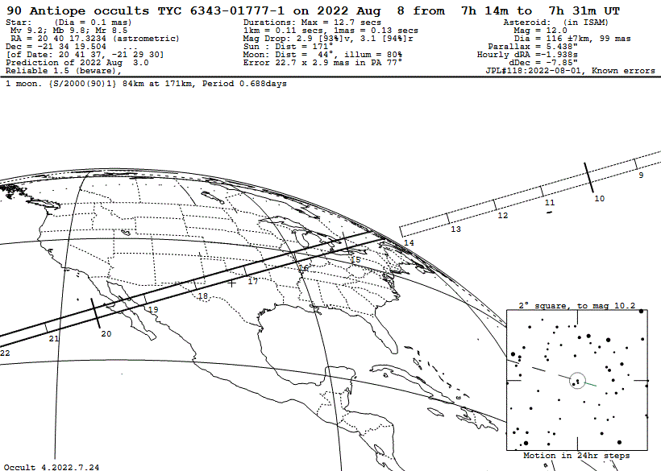
In Last Year’s Presentation: 2022 08 08 (90) Antiope

Slide 3
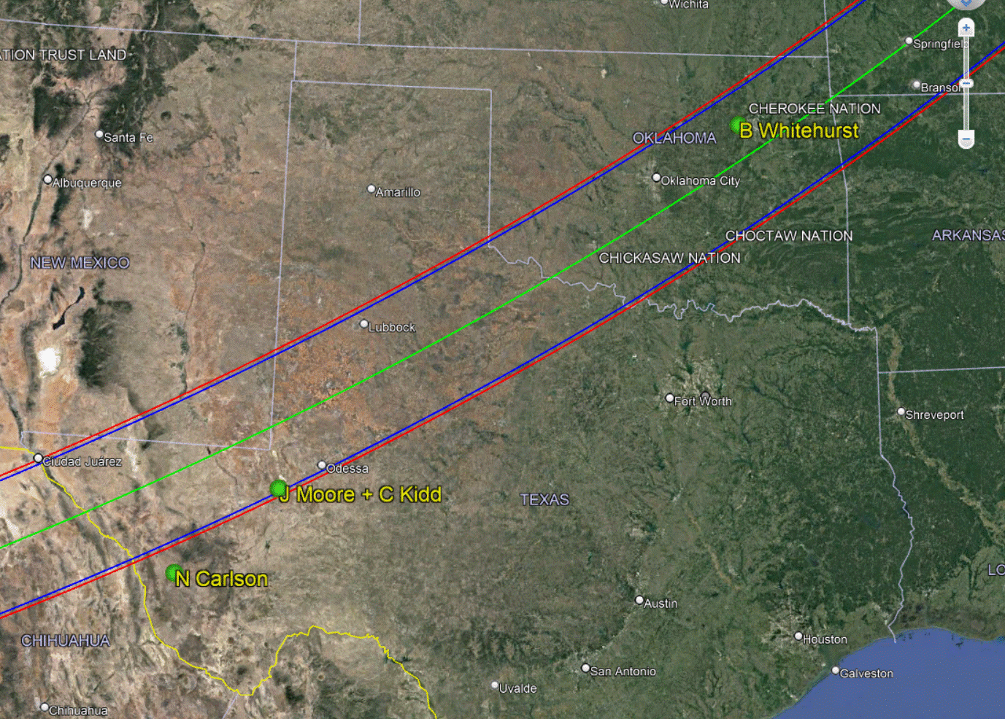

Slide 4
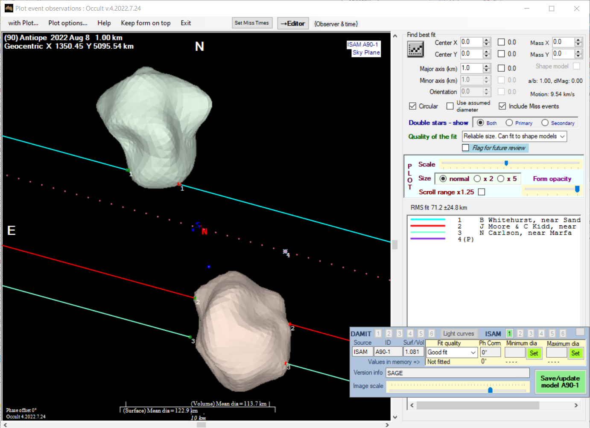

Slide 5
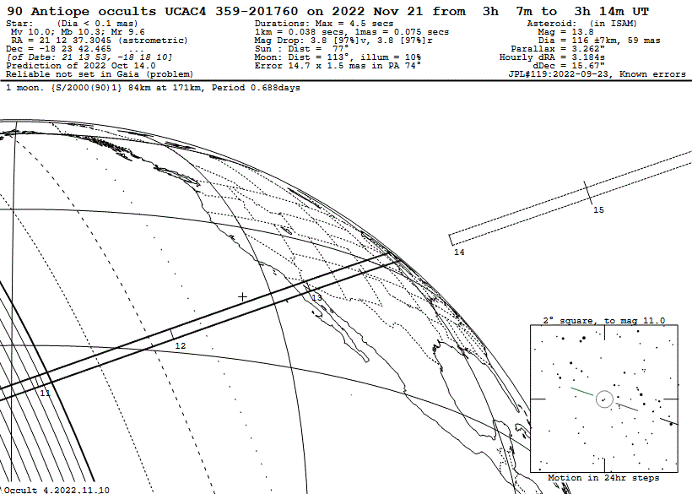
This Year: 2022 11 21 (90) Antiope
2022 08 08 (90) Antiope

Slide 6
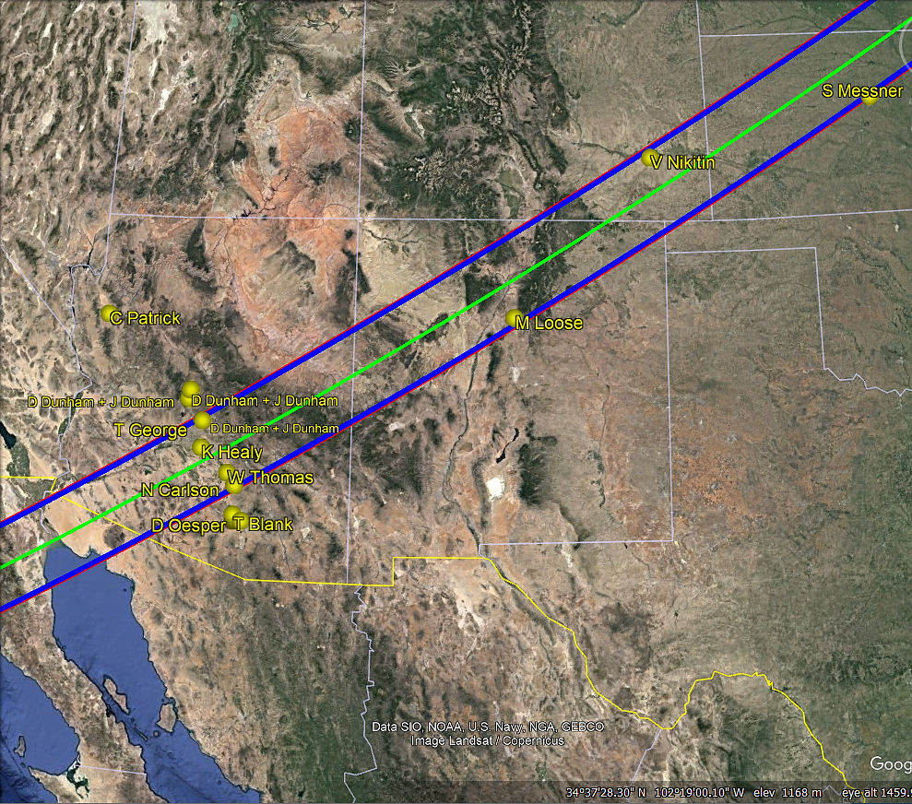

Slide 7
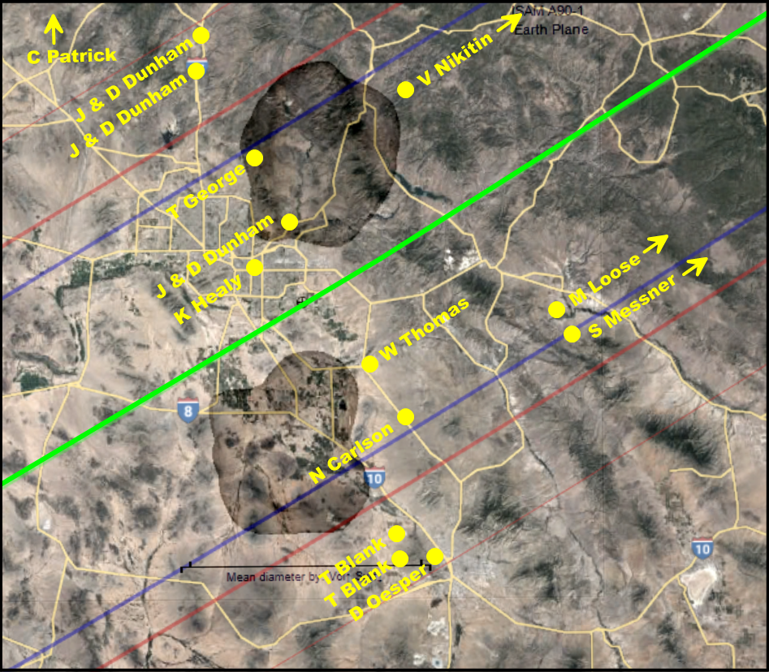

Slide 8
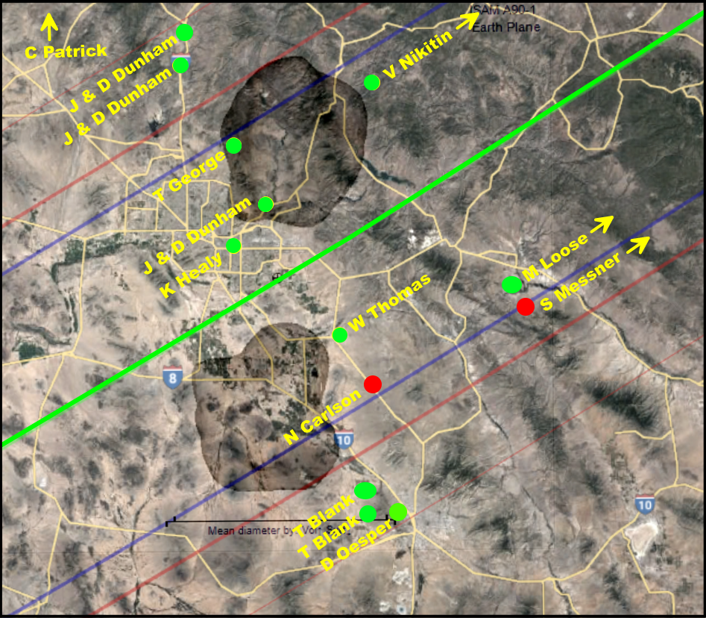
Results

Slide 9
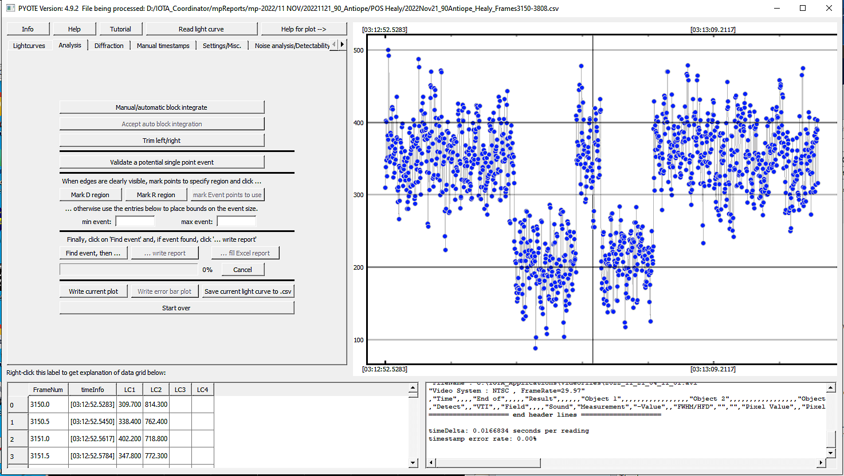
2022 11 21 (90) Antiope K. Healy Light Curve

Slide 10
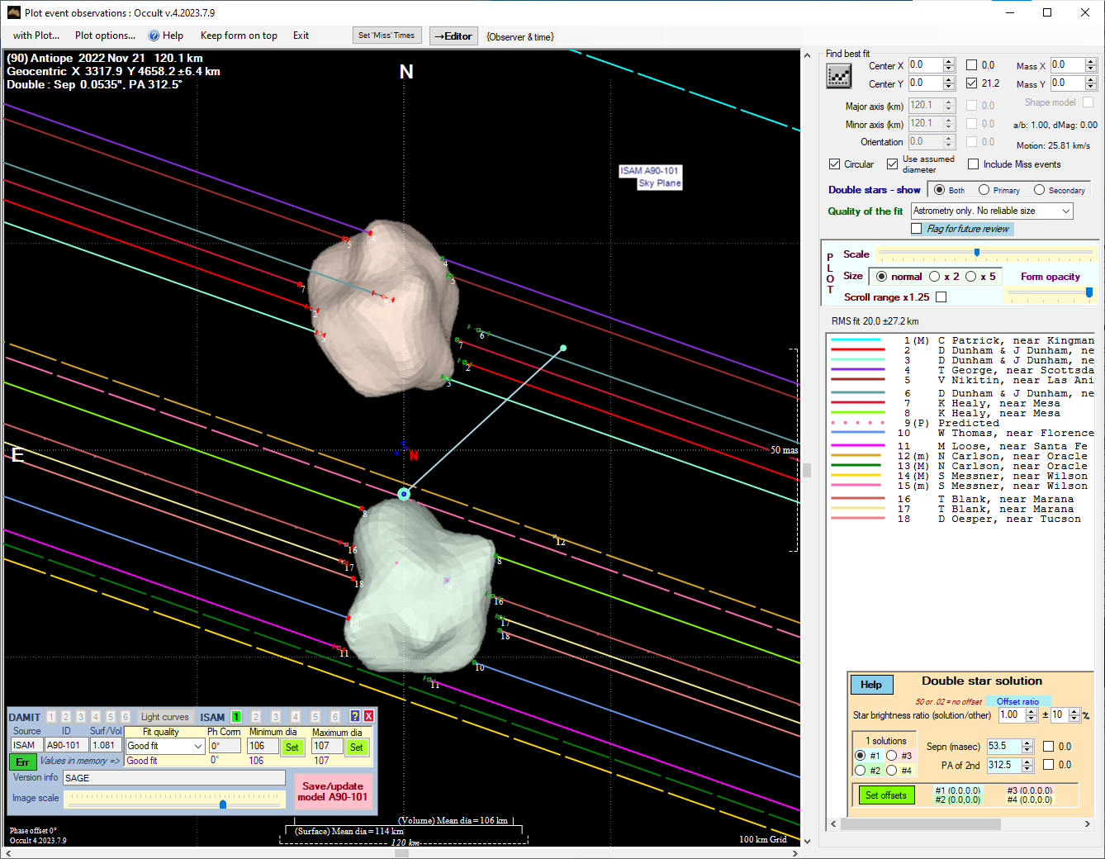

Slide 11
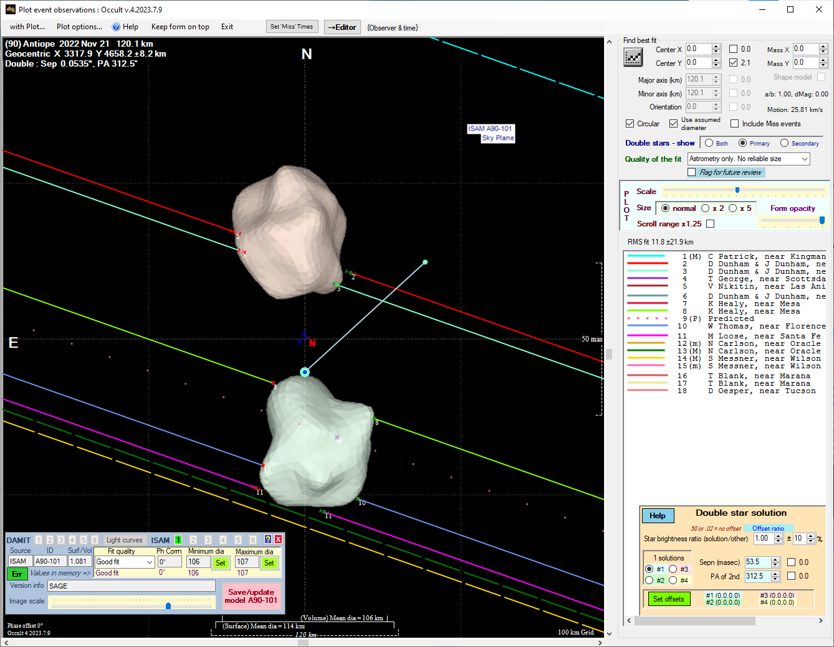

Slide 12
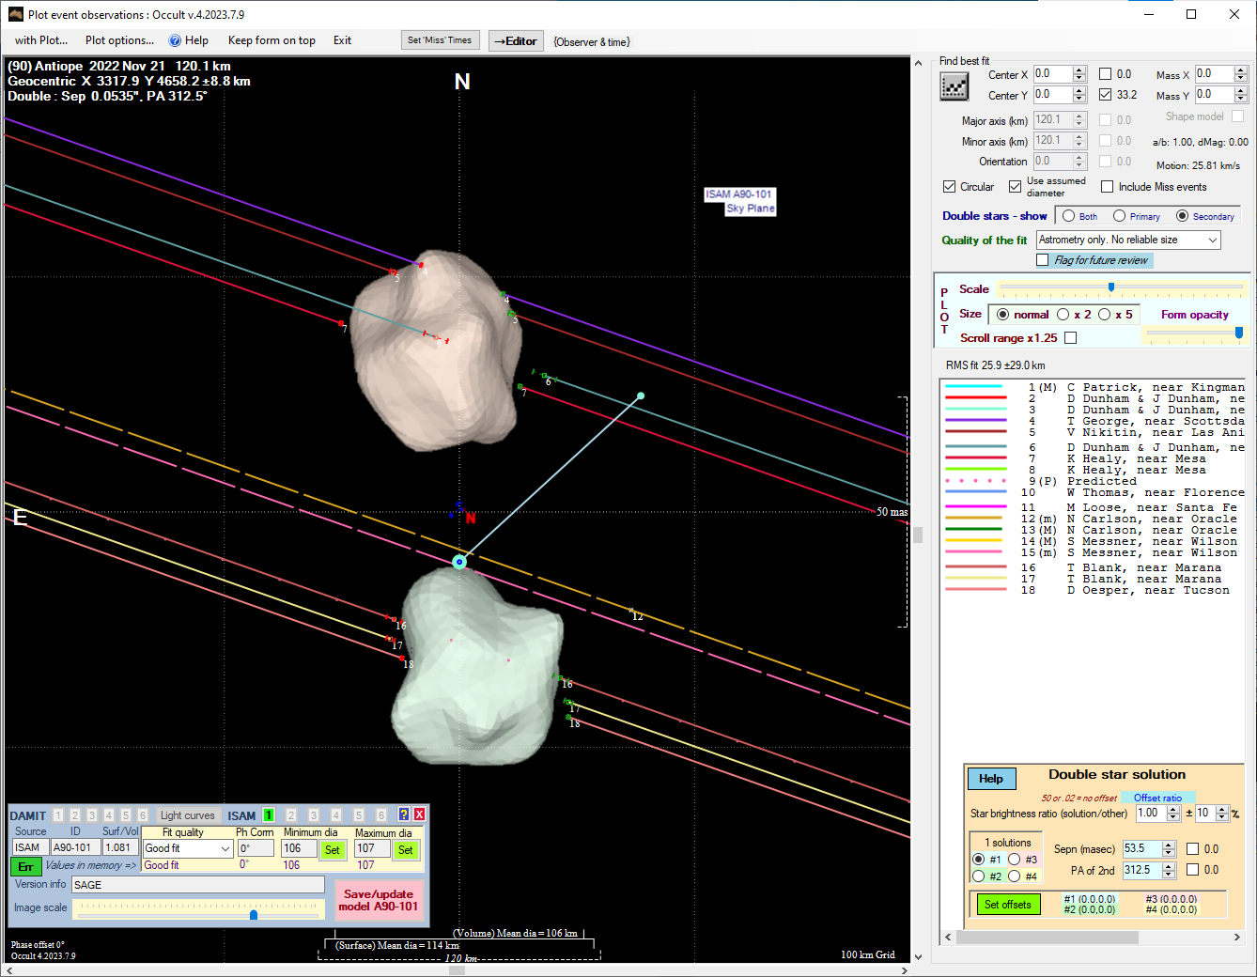

Slide 13
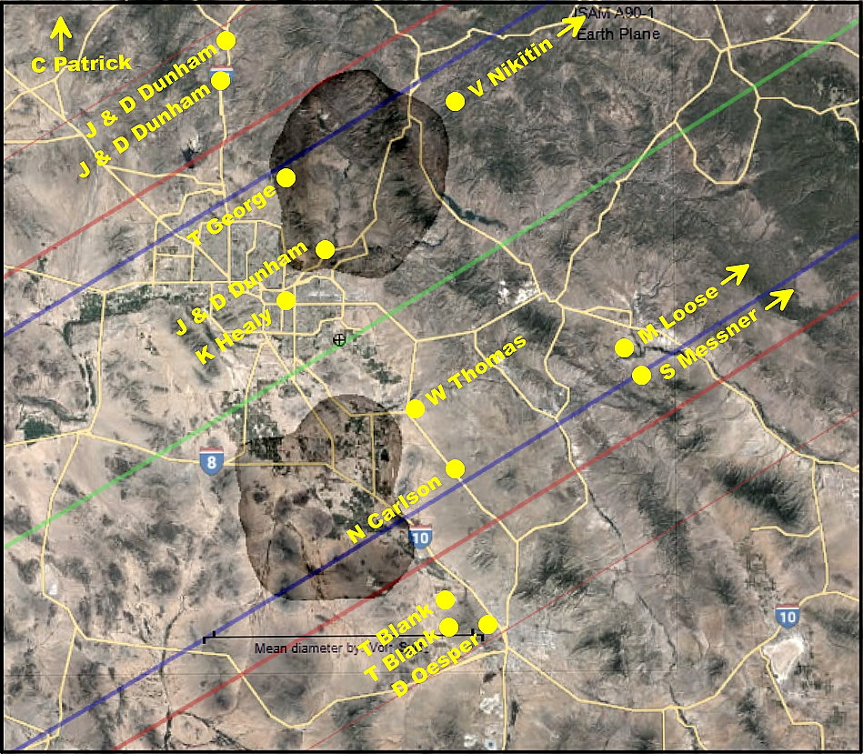

Slide 14
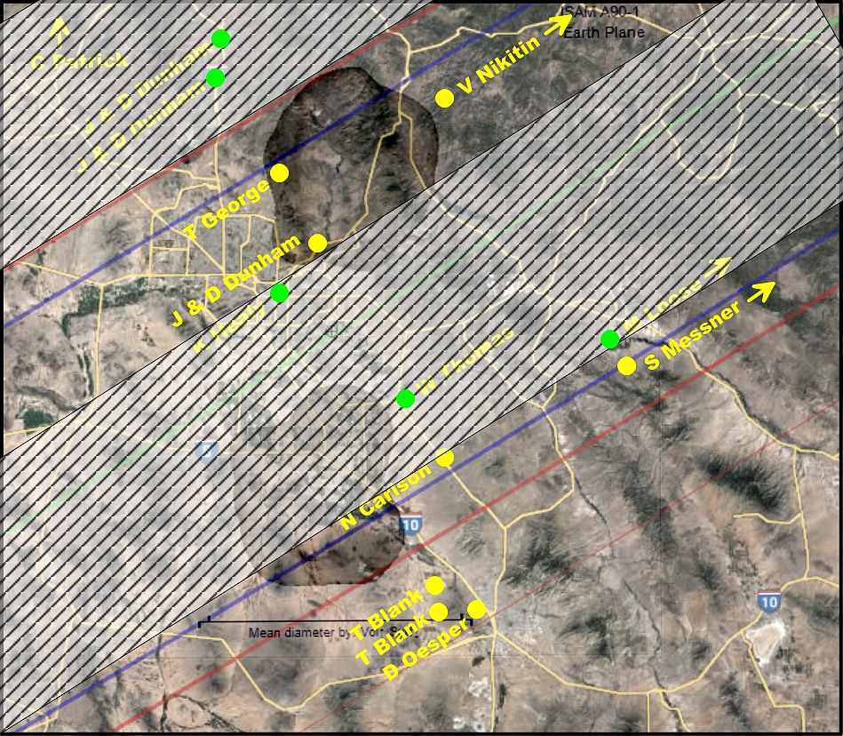
Shadow from Primary
Star Of Northern Body
Shadows from
Primary Star
Shadow from Primary Star
Of Southern Body

Slide 15
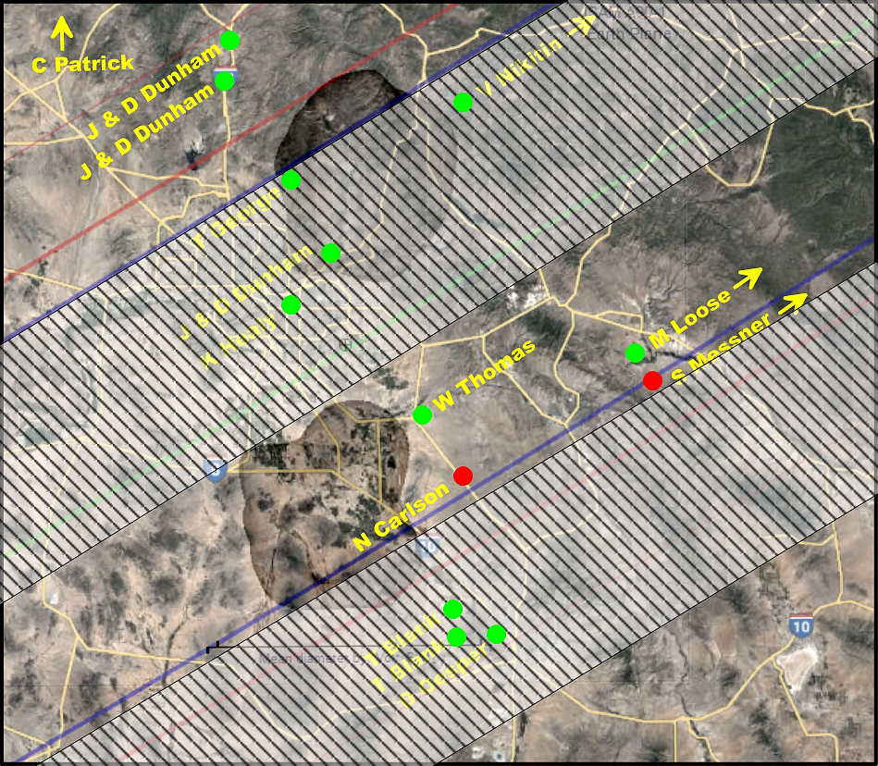
Shadow from Secondary
Star Of Northern Body
Shadows from
Secondary Star
Shadow from Secondary Star
Of Southern Body

Slide 16
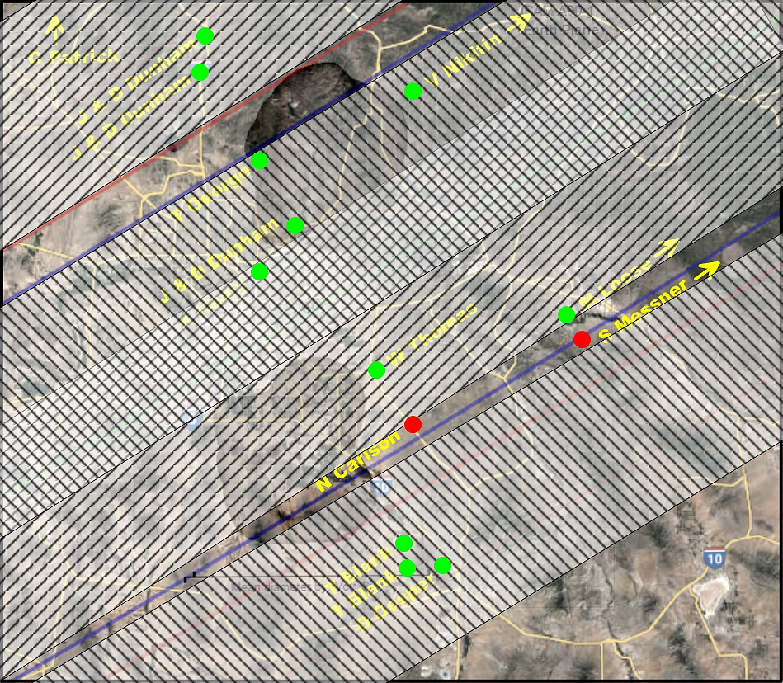
Shadows from
Both Stars

Slide 17
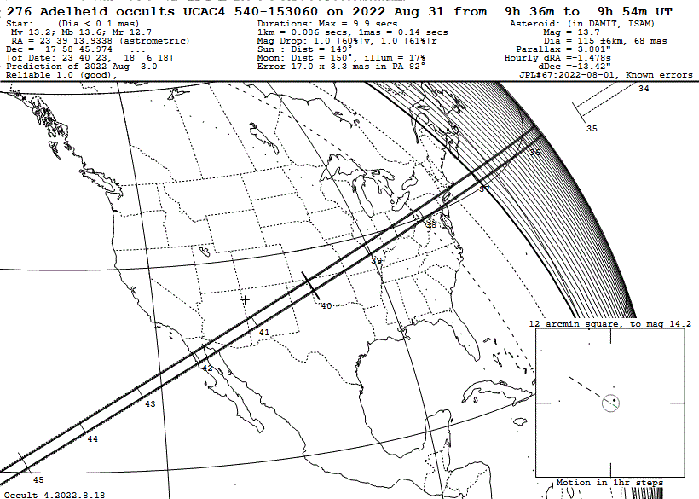
2022 08 31 (276) Adelheid
Possible Satellite Discovery

Slide 18
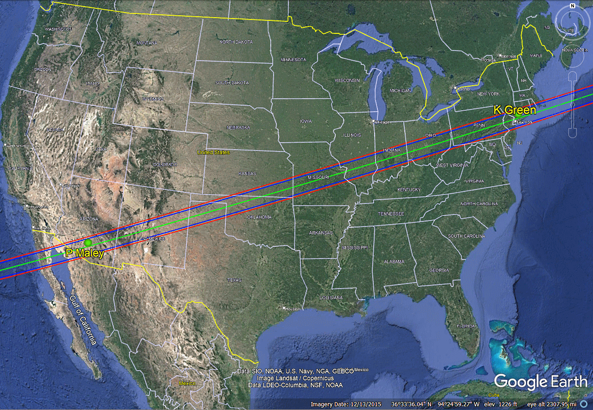
2022 08 31 (276) Adelheid
Possible Satellite Discovery

Slide 19
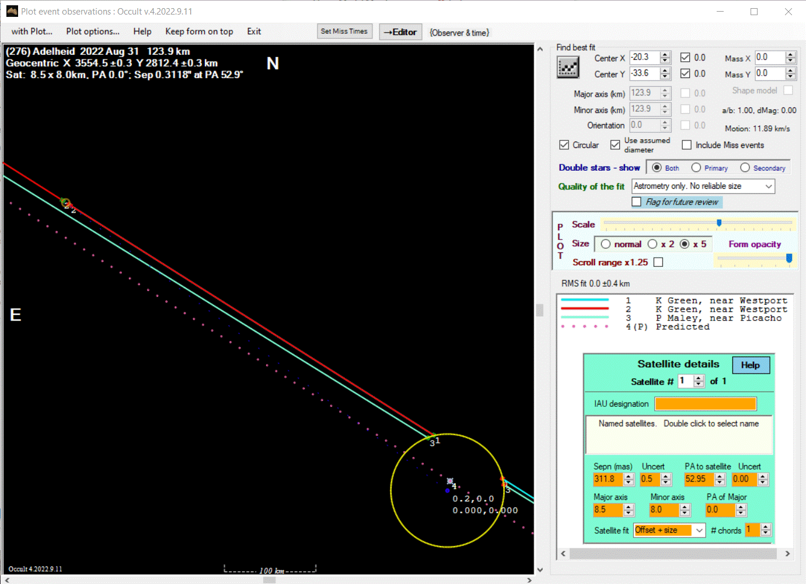
2022 08 31 (276) Adelheid
Possible Satellite Discovery

Slide 20
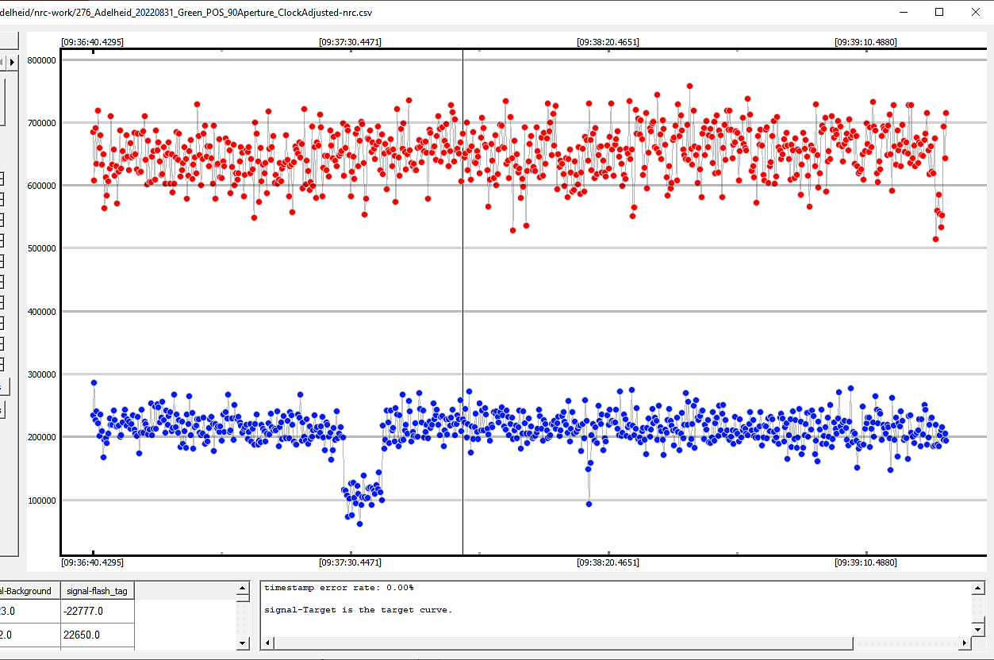
2022 08 31 (276) Adelheid
Possible Satellite Discovery

Slide 21
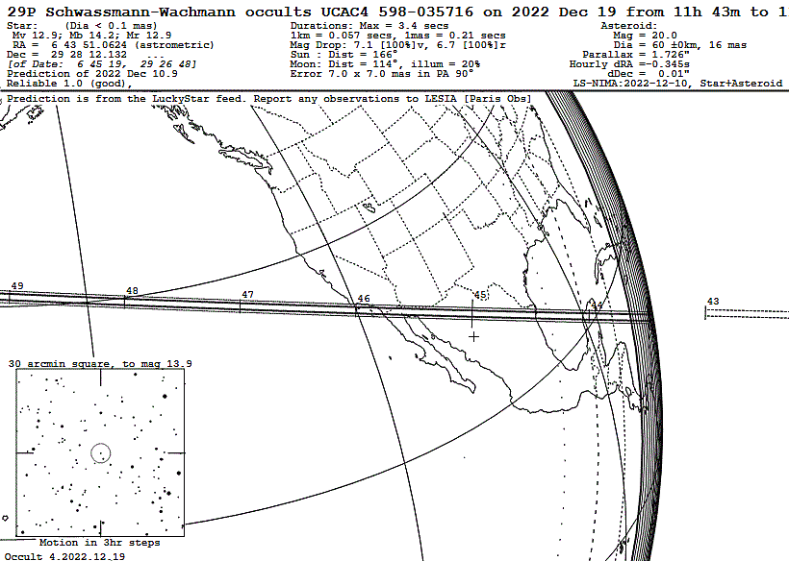
2022-12-19 29P Schwassmann-Wachmann 1

Slide 22
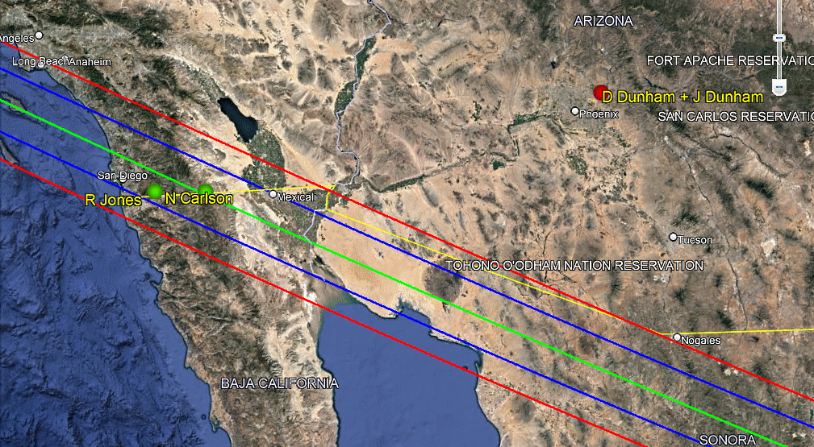
2022-12-19 29P Schwassmann-Wachmann 1

Slide 23
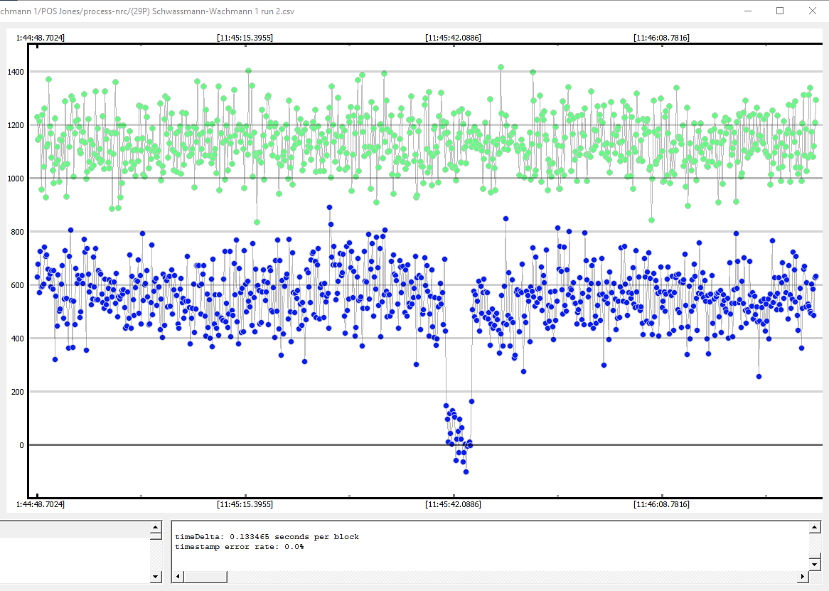
2022-12-19 29P Schwassmann-Wachmann 1

Slide 24
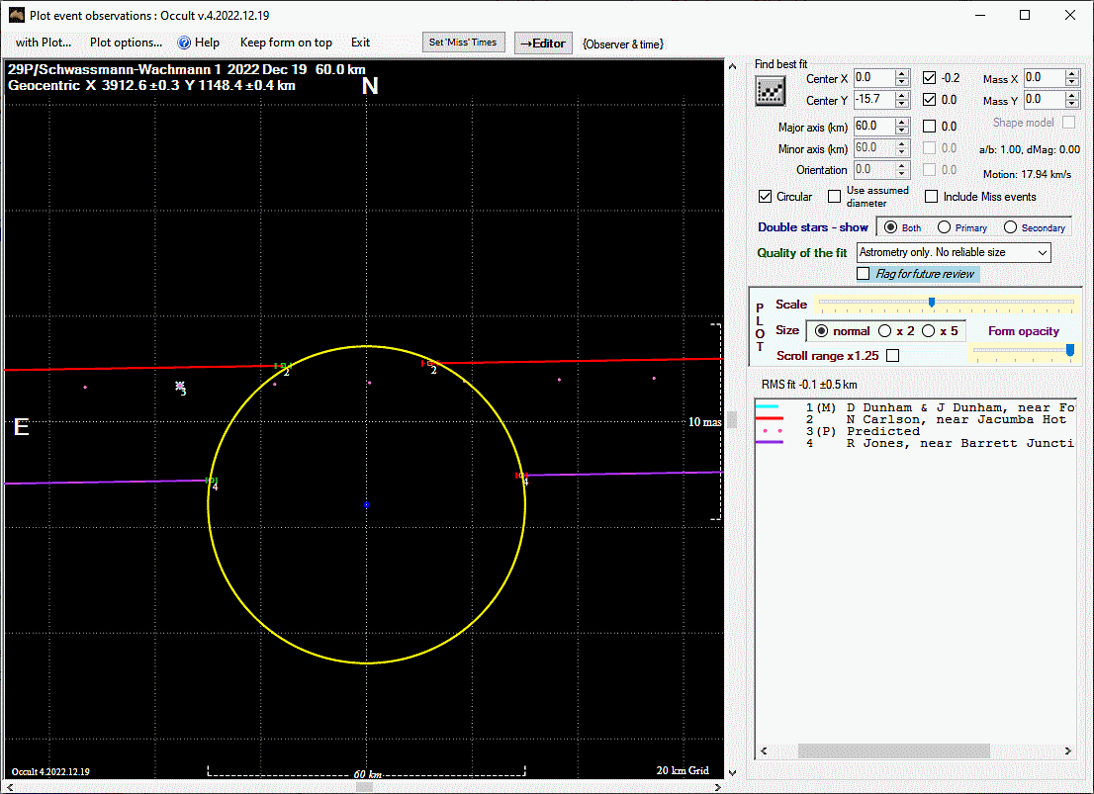
2022-12-19 29P Schwassmann-Wachmann 1

Slide 25
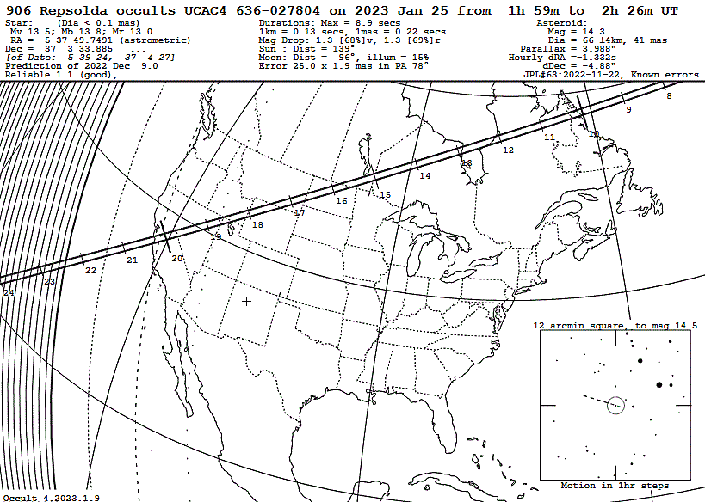
2023-01-25 906 Repsolda
Possible Satellite Discovery

Slide 26
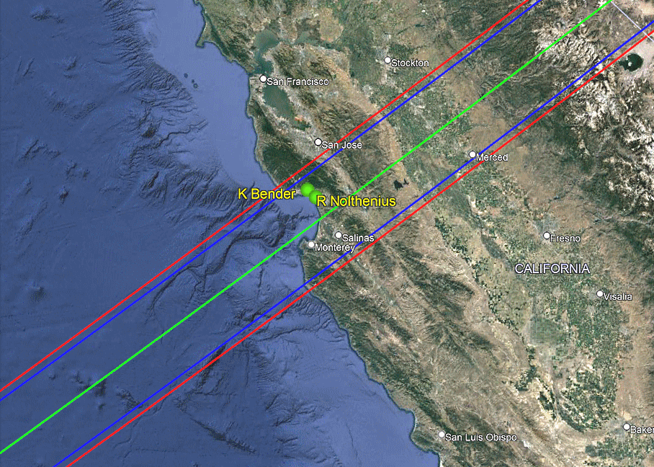
2023-01-25 906 Repsolda
Possible Satellite Discovery

Slide 27
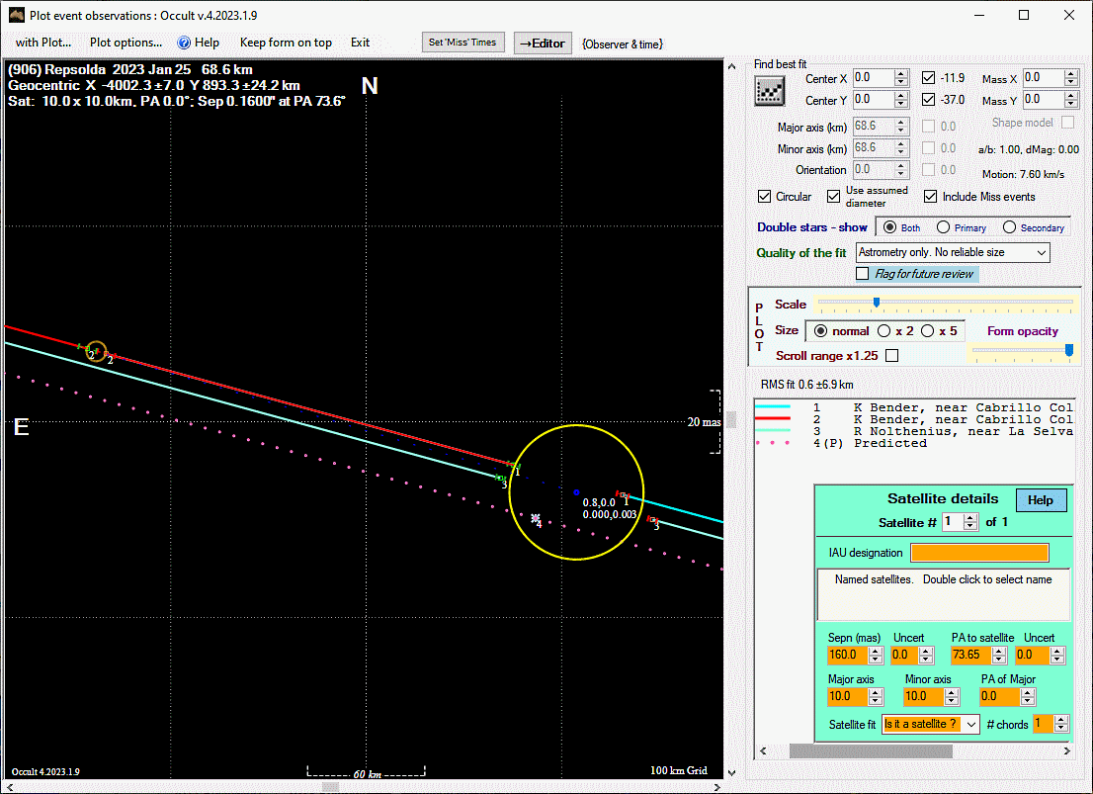
2023-01-25 906 Repsolda
Possible Satellite Discovery

Slide 28
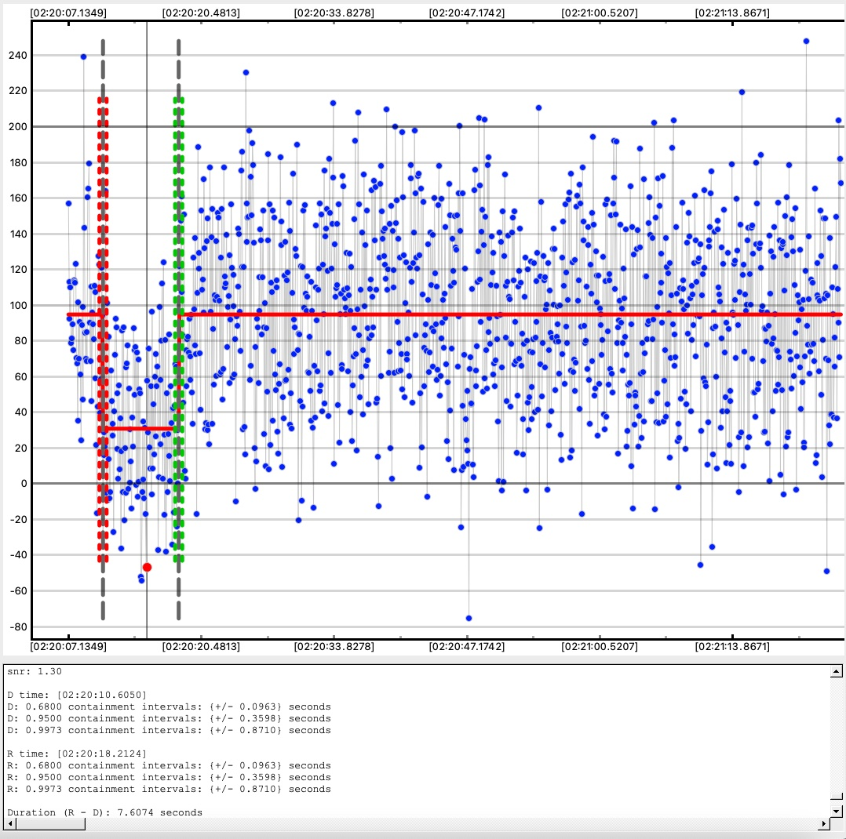
2023-01-25 906 Repsolda
Possible Satellite Discovery

Slide 29
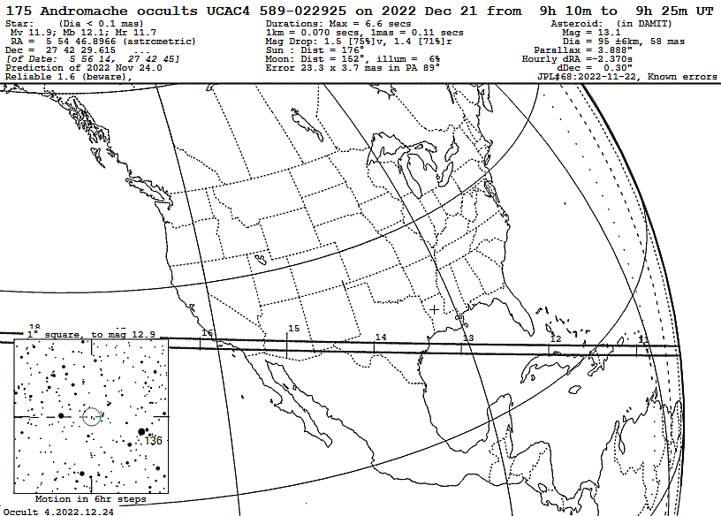
2022-12-21 175 Andromache
Double Star

Slide 30
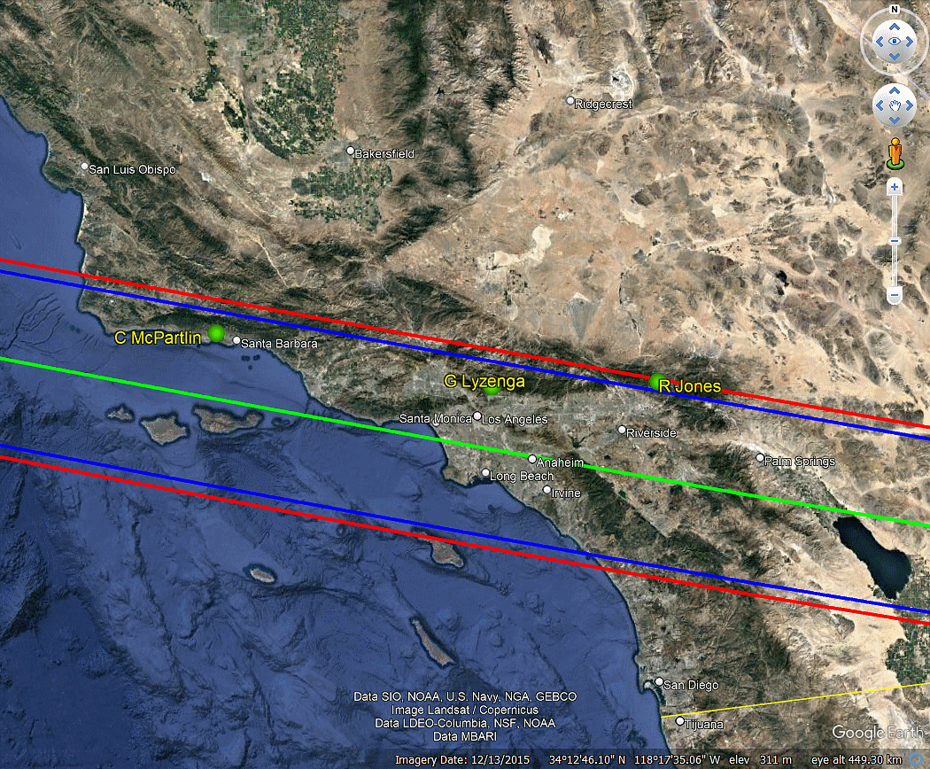
2022-12-21 175 Andromache
Double Star

Slide 31
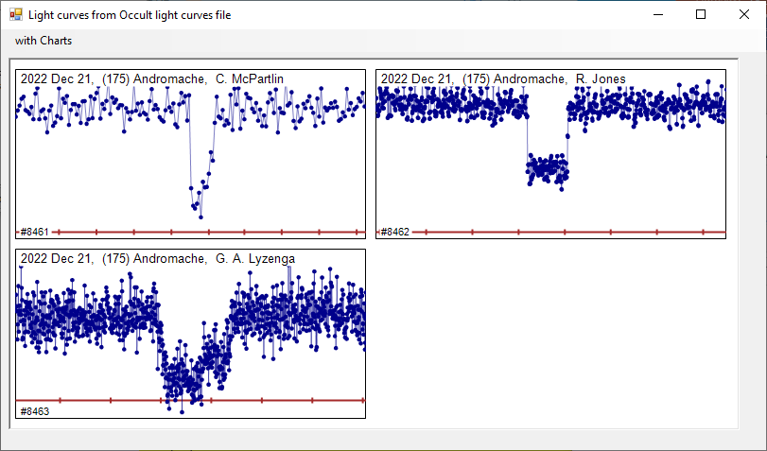
2022-12-21 175 Andromache
Double Star

Slide 32
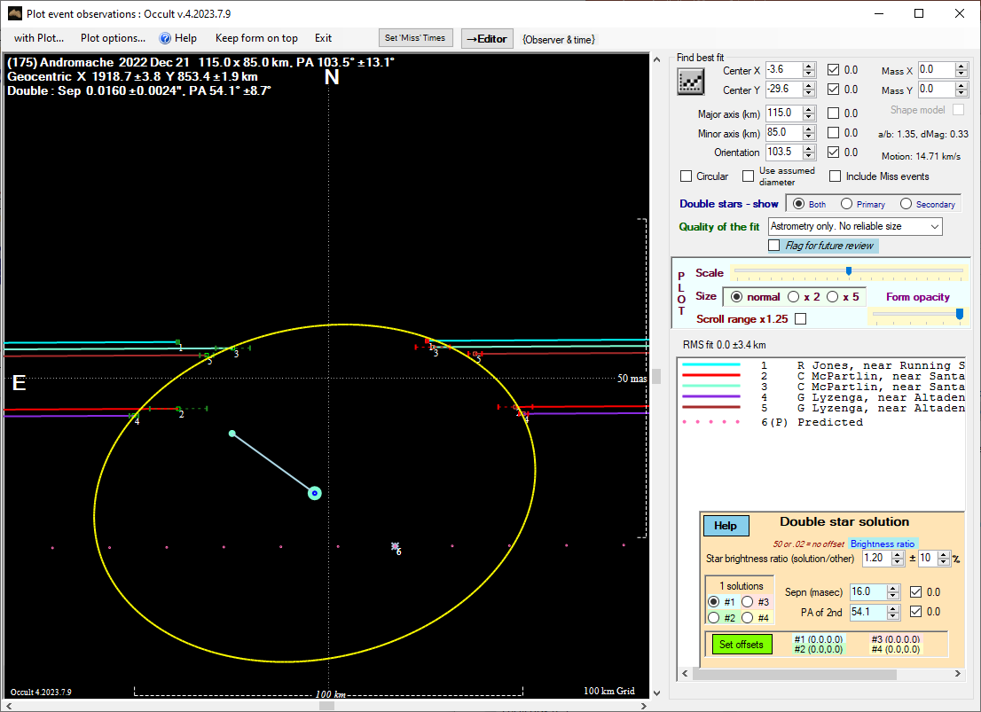
2022-12-21 175 Andromache
Double Star

Slide 33
2022-12-21 175 Andromache
Double Star

Slide 34
2022-12-21 175 Andromache
Double Star

Slide 35
65803 Didymos & Dimorphos
2022/10/15 2+, 4m Dunford, Venable(4)
2022/10/21 1+, 1m Dunham, Jones
2022/10/27 3+, 1m Cobble, Moore, Whitehurst, Carlson
2022/11/12 4+ Jones, Maley, Nolthenius, Carlson
2022/11/14 2+ J&D Dunham(2)
2022/11/15 3+ Jones, Lyzenga, Preston
2022/12/19 6+ Getrost, Venable(5)
2022/12/23 1+ Venable
2023/01/18 2+, 2m Venable(4), Carlson

Slide 36
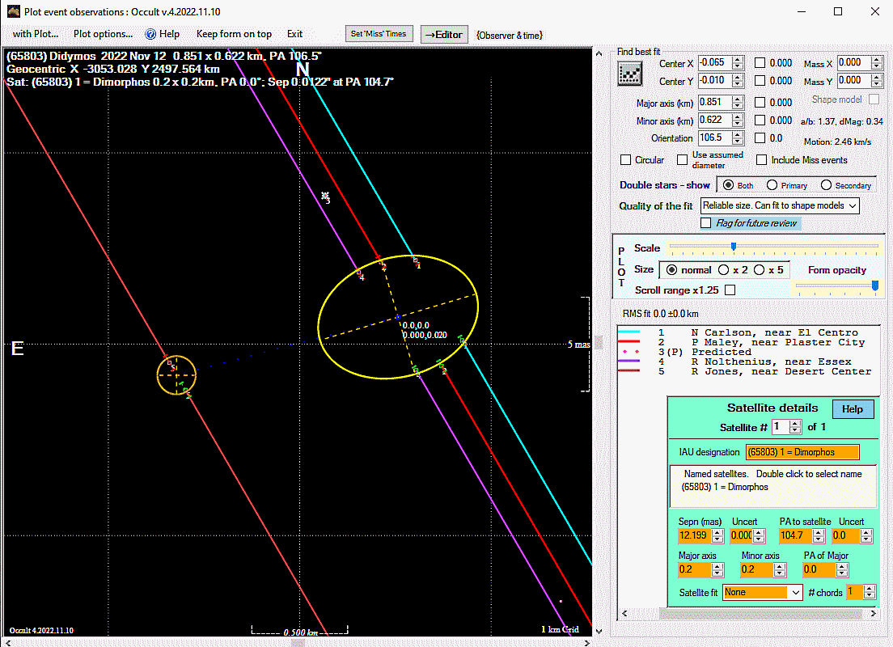
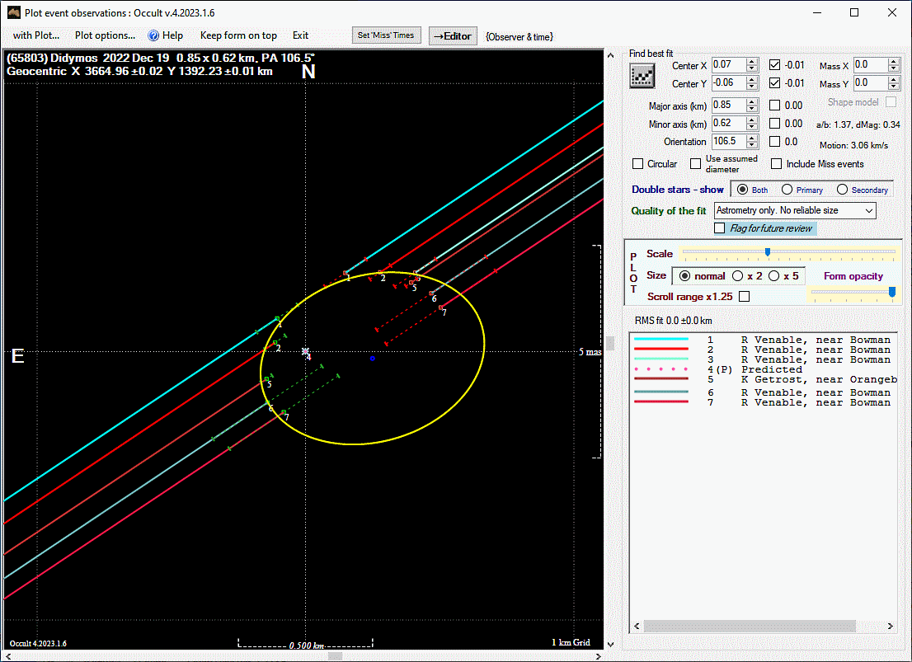
65803 Didymos & Dimorphos

Slide 37
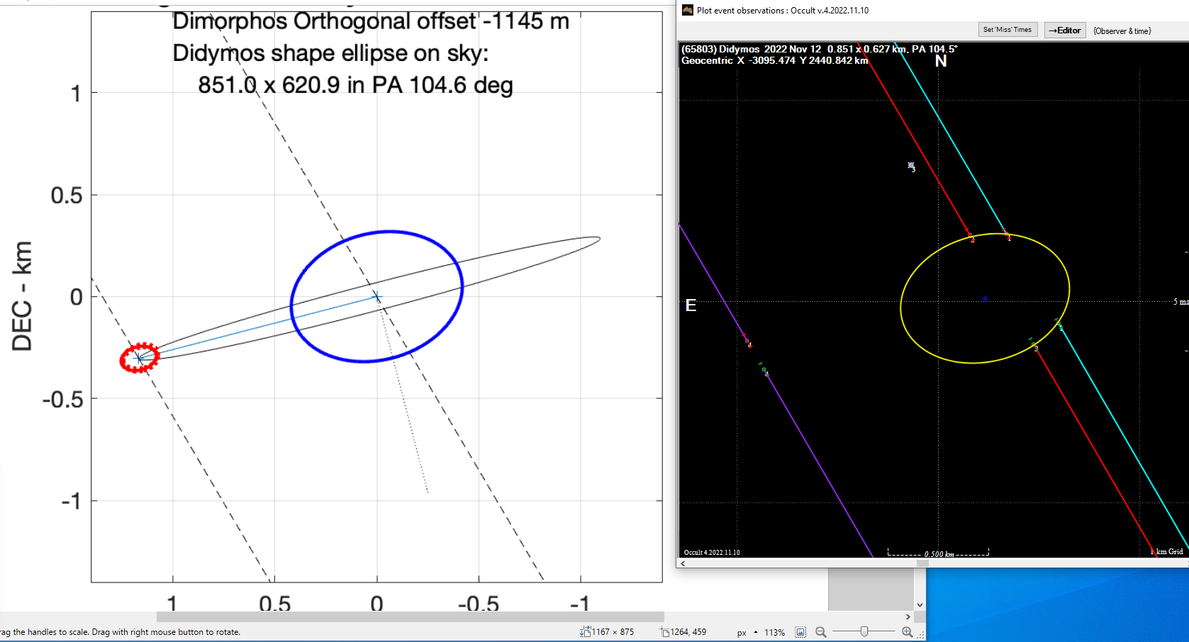
65803 Didymos & Dimorphos

Slide 38
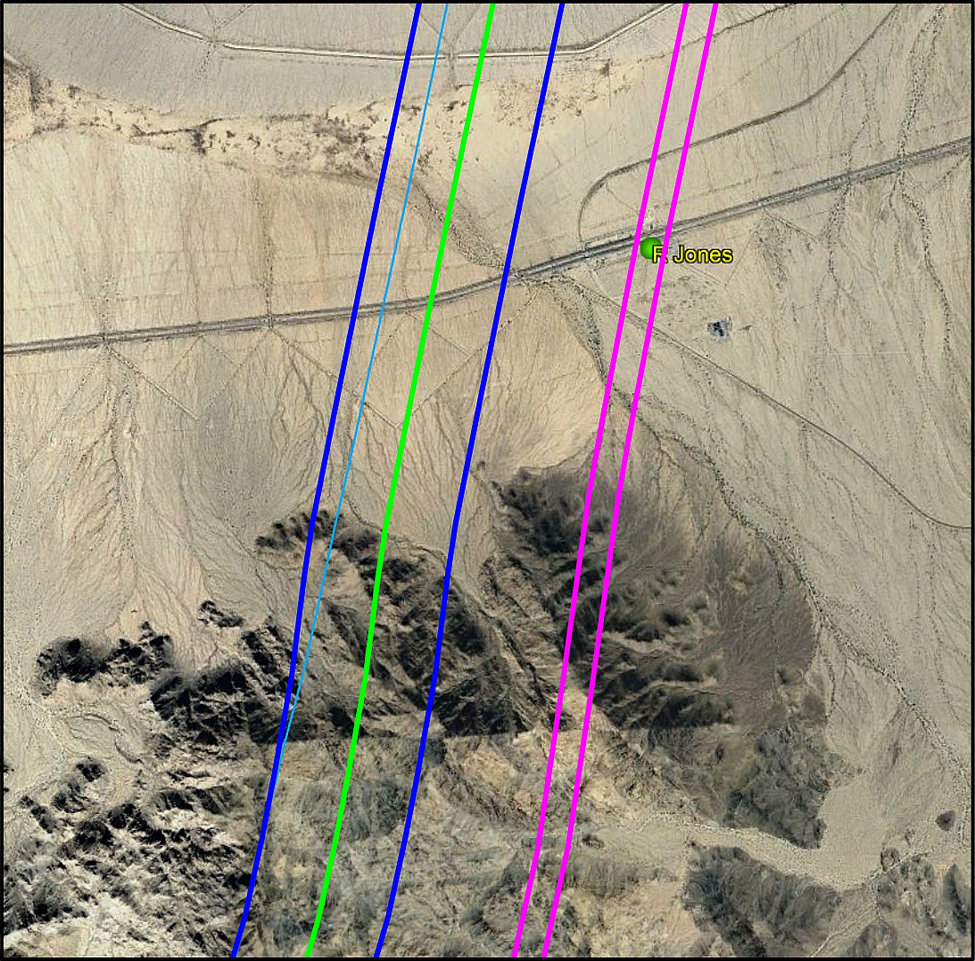
65803 Didymos & Dimorphos
Elevation-corrected
Prediction
of
Didymos and
Dimorphos

Slide 39
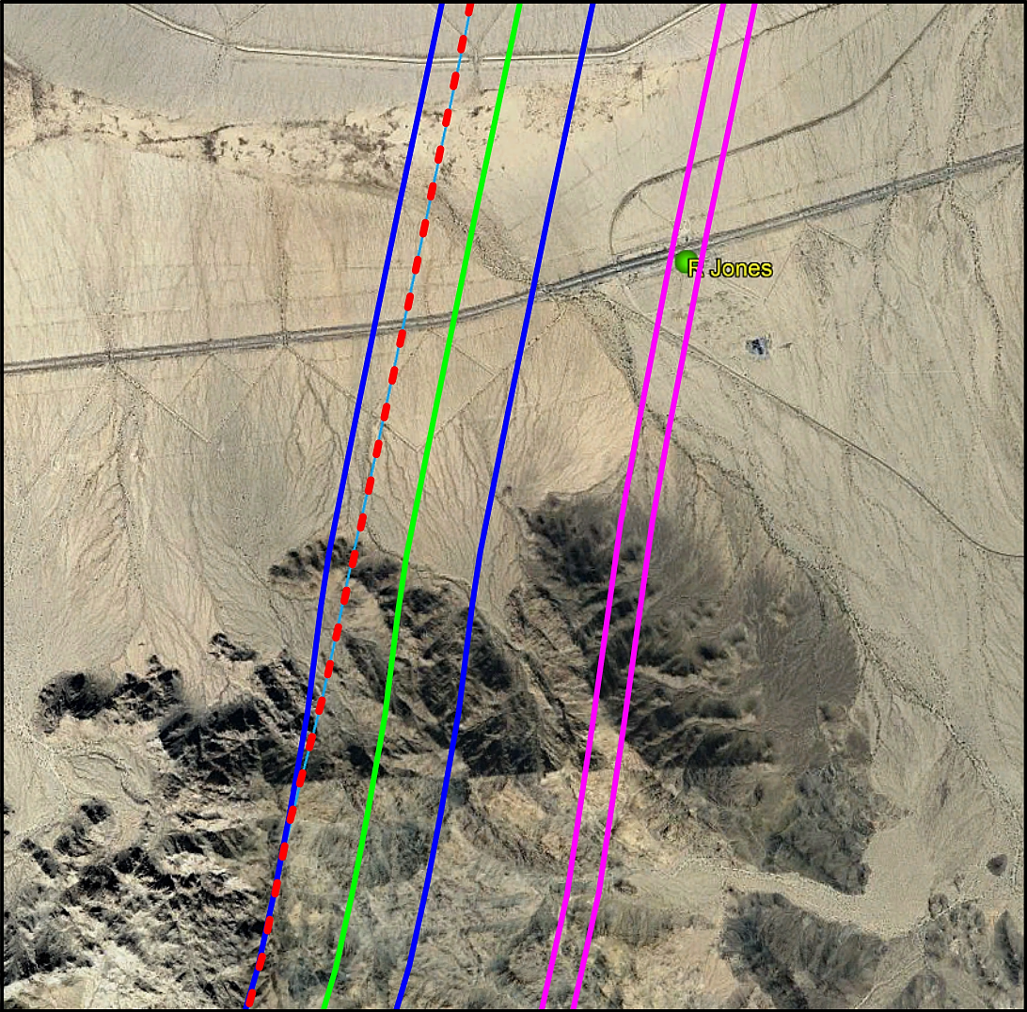
65803 Didymos & Dimorphos
Red-dashed line:
Didymos
Centerline
(no elevation
correction)

Slide 40
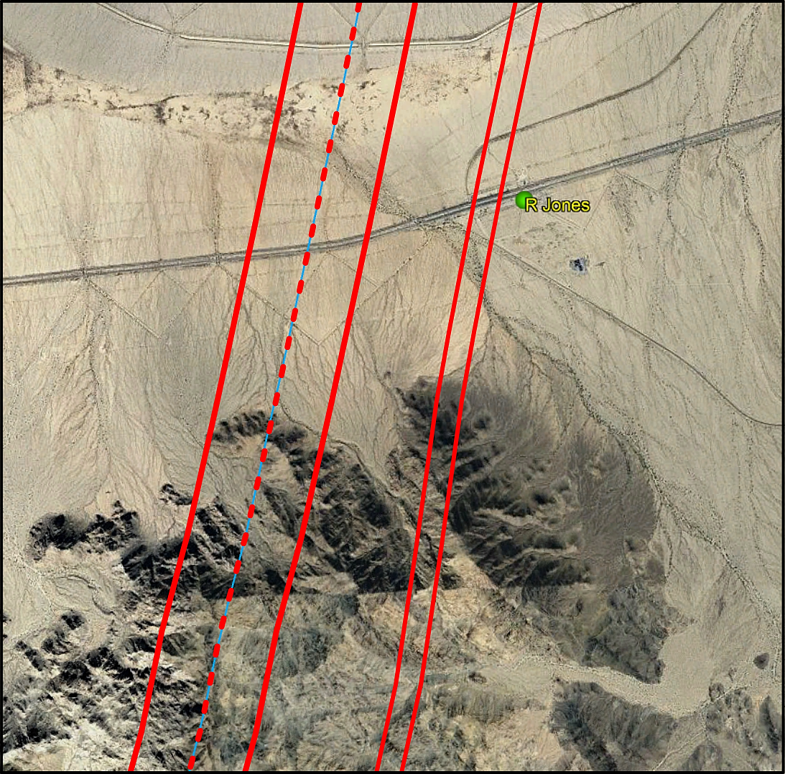
65803 Didymos & Dimorphos
Prediction Paths
(no elevation
correction)

Slide 41
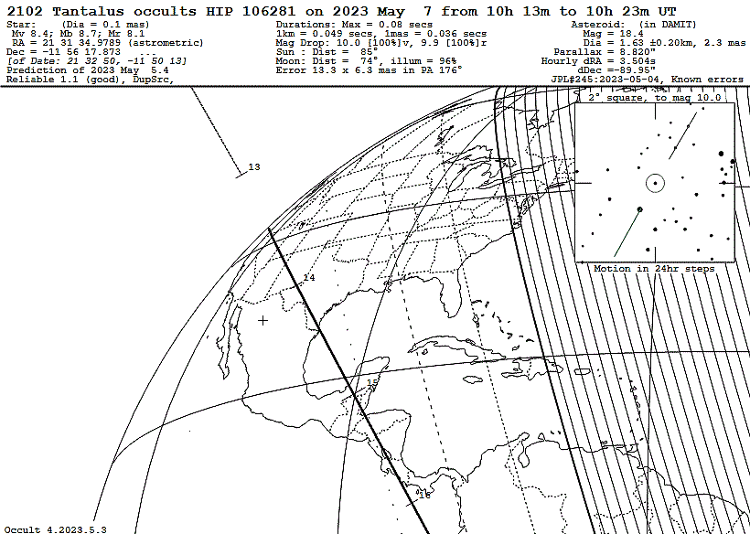
2023-05-07 2102 Tantalus

Slide 42
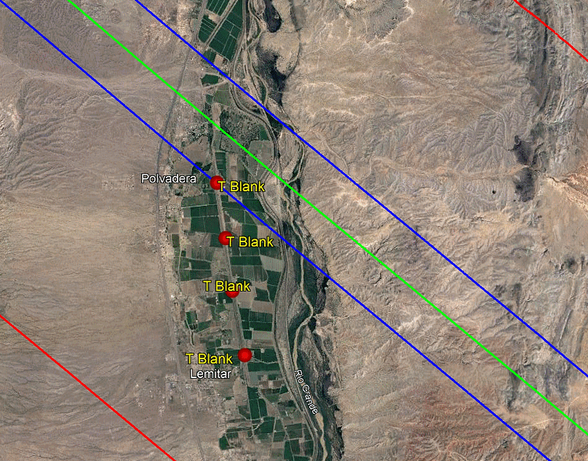
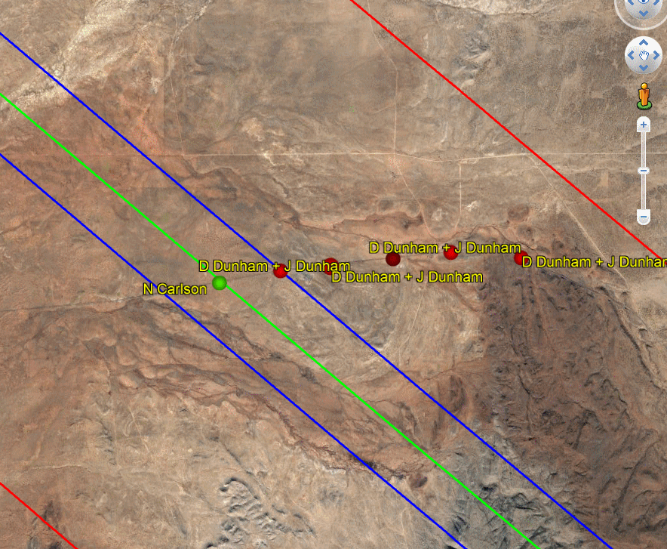
2023-05-07 2102 Tantalus

Slide 43
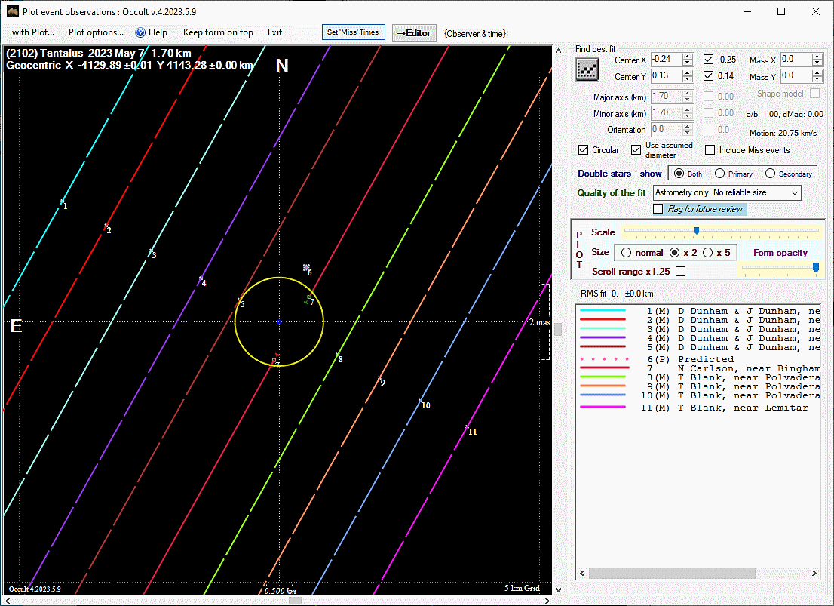
2023-05-07
2102 Tantalus

Slide 44
IOTA North America Review Team
Jerry Bardecker
Bob Dunford
Ernie Iverson
Steve Messner
John Moore – Coordinator Emeritus
Tony George – Difficult Observations Analyst – “The Shadow Whisperer”
Johnny Barton – Tangra Support
Dave Eisfeldt – Tangra Support
Dave Gault
Dave Herald
{
R²
^{Team}
Thanks!
Clear Skies & High SNRs!

